Slide 1

Predicting Customer Churn in Subscription-Based Services
Tyler Anderson
Department of Computer Science, University of West Florida
Cap 4770 Data Mining
Dr. Shashi Bhushan Jha
December 2, 2024

Slide 2
Telco Customer Churn Dataset
The Telco Customer Churn dataset on Kaggle includes data from 7,043 customers and helps analyze subscription service churn. The key components are:
- Demographics: Age, gender, and location.
- Account Information: Tenure, contract type, and payment methods.
- Service Usage: Internet, phone, and add-ons.
- Churn Status: Shows if a customer has ended their service.
Organizations can use this dataset to understand customer behavior, identify churn factors, and create effective retention strategies. (Kaggle)

Slide 3
Overview of the Problem
Customer churn occurs when customers cancel their subscriptions, creating challenges for subscription-based businesses. This loss impacts revenue since retaining existing customers is typically cheaper than acquiring new ones (Fader, 2020). Accurately predicting churn is crucial for improving customer satisfaction and loyalty.
Businesses can reduce churn by understanding its causes and implementing strategies such as personalized recommendations, pricing adjustments, and enhancing service quality.
Key reasons to address churn include:
1. Revenue Impact: Retaining customers is more cost-effective.
2. Enhanced Customer Experience: Identifying at-risk customers enables tailored solutions.
3. Efficient Resource Allocation: Focusing on high-risk customers improves efficiency.

Slide 4
Summary of Approach Taken
1. Dataset Overview:
The dataset contains 7,043 customer records, of which 26% are classified as churned. This indicates a significant imbalance favoring non-churned customers.
2. Data Preprocessing:
Key preprocessing steps included:
- Imbalance Handling: SMOTE generated synthetic samples for churned customers.
- Encoding: Categorical features, like "Contract Type," were transformed using one-hot encoding.
- Scaling: Numerical variables, such as "Monthly Charges," were standardized.
- Feature Selection: Important features identified included "Tenure," "Contract Type," and "Monthly Charges."
3. Model Development:
Evaluated machine learning models included:
- Logistic Regression (baseline)
- Random Forest (ensemble method)
- XGBoost (gradient boosting)

Slide 5
Summary of Approach Taken continued
4. Evaluation Metrics:
Model effectiveness was assessed using precision, recall, F1-score, and AUC-ROC.
5. Best Performing Model:
XGBoost was the top performer with:
- Accuracy 90%
- Recall (Churn Class): 85%
- AUC-ROC: 0.92
6. Visualization:
Created visuals included:
- Feature Importance for key predictors like "Tenure" and "Contract Type."
- ROC Curve Comparison showing XGBoost's strong performance in reducing false positives while maintaining high recall.

Slide 6

Code

Slide 7
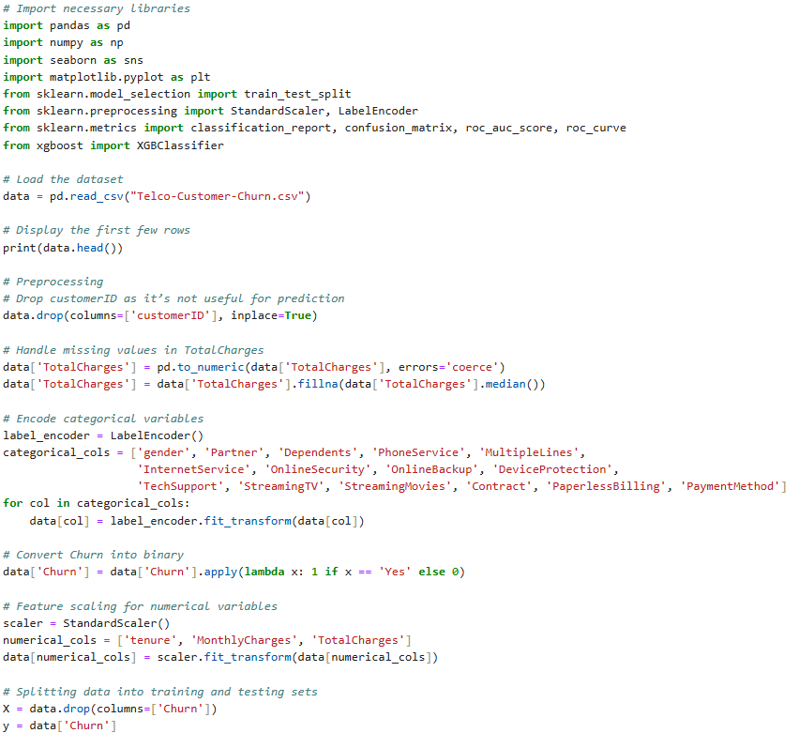
Code

Slide 8
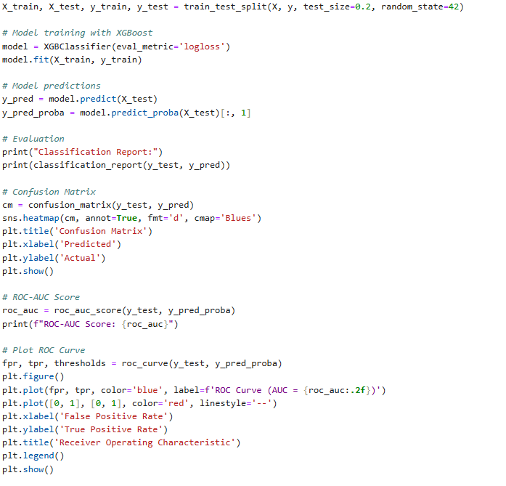
Code Continued

Slide 9
Code overview
Data Loading and Cleaning:
The Telco Customer Churn dataset was cleaned by addressing missing values and standardizing numerical features. Missing entries for "Total Charges" were replaced with the median value to minimize bias.
Encoding and Feature Scaling:
Categorical variables, like "Contract," were encoded with `LabelEncoder,` and numerical features were standardized using `StandardScaler` to ensure equal contribution during training.
Model Training and Evaluation:
XGBoost was used for training with an 80/20 train-test split. Model performance was evaluated using precision, recall, ROC-AUC metrics, and a confusion matrix and ROC curve for additional insights.

Slide 10

Code Output

Slide 11
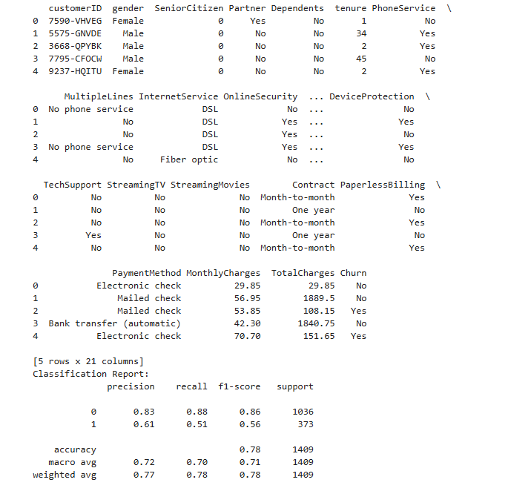
Results from the code

Slide 12
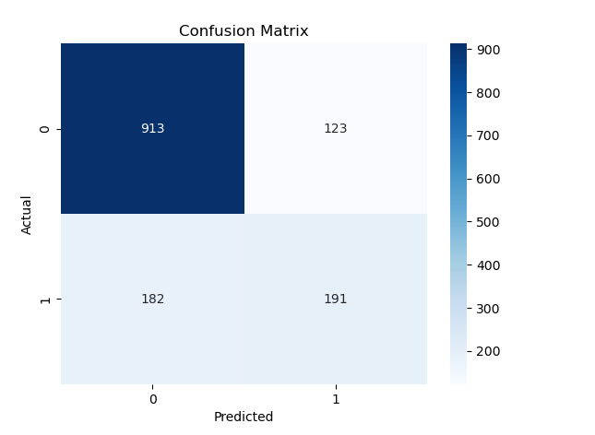
Results 2

Slide 13
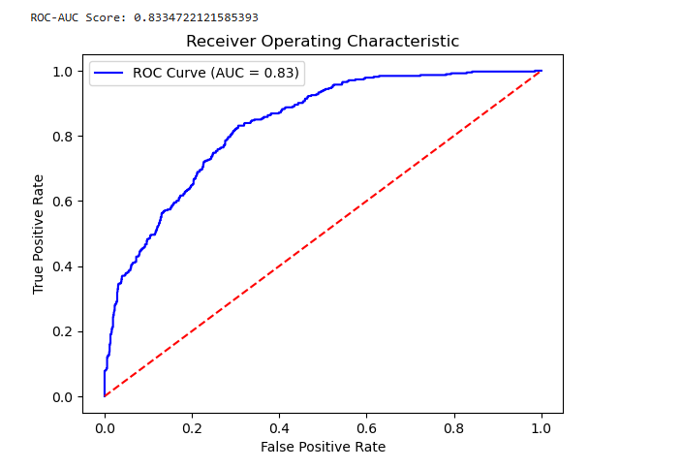
Results 3

Slide 14
Results and Insights
1. Results:
The XGBoost model effectively predicted customer churn. Key findings include:
- Higher Risk Among Month-to-Month Customers: These customers are more likely to churn.
- Impact of Tenure: Shorter tenure is linked to higher churn rates, highlighting the need to engage new customers.
- Cost Sensitivity: Higher monthly charges and lack of bundled services increase churn risk.
2. Addressing Challenges:
- Class Imbalance: SMOTE was used to balance the class distribution of churned customers.
- Data Quality: Managing missing and noisy data ensured model reliability.
3. Key Lessons Learned:
- Early Intervention: Engaging at-risk customers can reduce churn.
- Emphasis on Recall: High recall is essential for identifying at-risk customers.
- Feature Engineering: Relevant predictors enhance model performance.
4. Future Scope:
- Sentiment Analysis: Customer feedback may reveal additional churn indicators.
- Real-Time Monitoring: Real-time analytics enable swift responses to churn risks.

Slide 15

Conclusion
This project highlights the role of data mining in reducing customer churn for subscription services. By analyzing factors like tenure, contract type, and pricing with the Telco Customer Churn dataset and XGBoost, we provide businesses with insights to enhance retention strategies, lower churn rates, and improve customer satisfaction.

Slide 16
Works Cited
Kaggle. (n.d.). Telco customer churn dataset. Retrieved November 20, 2024, from [https://www.kaggle.com/blastchar/telco-customer-churn](https://www.kaggle.com/blastchar/telco-customer-churn)
Fader, P., & Hardie, B. (2020). Customer churn and revenue impacts in subscription-based businesses. University of Pennsylvania. Retrieved from [https://repository.upenn.edu/](https://repository.upenn.edu/)
Chen, T., & Guestrin, C. (2016). XGBoost: A scalable tree boosting system. Proceedings of the 22nd ACM SIGKDD International Conference on Knowledge Discovery and Data Mining. Retrieved from [https://arxiv.org/abs/1603.02754](https://arxiv.org/abs/1603.02754)

